Slide 1
Cereals Data Analysis BY K.V.S.S SIDDHARTHA

Slide 2

The given data set consists of the following parameters:
• Name: Name of cereal
• mfr: Manufacturers
• type
○ C=Cold
○ H=hot
• calories
• protein
• fat
• sodium
• fiber
• carbo
• sugars
• potass
• vitamins
• shelf
• weight
• cups:
• rating:

Slide 3

Project analysis slide 3
Project Analysis
MARKET ANALYSIS
TECHNICAL ANALYSIS
FINANCIAL ANALYSIS
ECONOMIC ANALYSIS
ECOLOGICAL ANALYSIS
The global market for Breakfast Products is expected to increase to US$113 billion by 2023.
In global comparison, most revenue is generated in China (US$18,488m in 2019).
In relation to total population figures, per person revenues of US$47.42 are generated in 2019.
The average per capita consumption stands at 6.5 kg in 2019.
In global comparison, most revenue is generated in China (US$18,488m in 2019).
In relation to total population figures
Investment forecasting and level of confidence
Have been on a positive note
Yield of crop have been on raise and on par with due demand

Slide 4
Project analysis slide 2
Project Analysis
Exploratory Data Analysis
Features and Labels
PROJECT
Stats Model
Multiple Linear regression Analysis
Linear regression Analysis
Sklearn

Slide 5
Project analysis slide 4
Project Analysis
Fiber
.
Management Objectives
Rating of products
Parameters
protein
.
.
Customer Objectives
L
.
potass

Slide 6
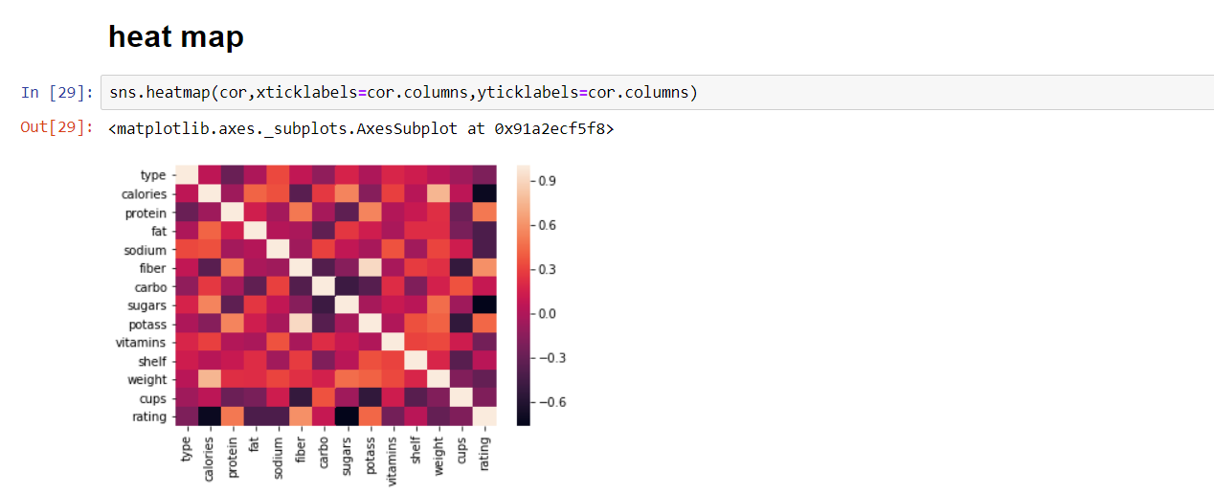
Project analysis slide 5
Project Analysis
positive corelated
Negative corelated
Moderately corelated
3
4
2
Protein ,fiber and potass
Calories , sugars and cups
Shelf and carbon

Slide 7
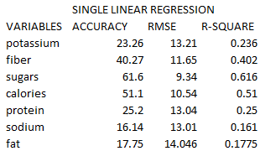

Slide 8
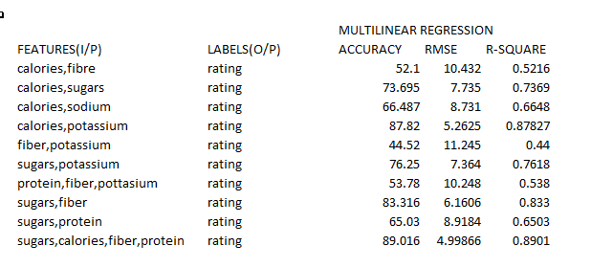

Slide 9
Project analysis slide 6
Project Analysis
Which product among these are preferable and health friendly
How to make the customer choose our product
what makes the customer choose the product
How to overcome the competitive pricing and increase the sales of the product.
Best marketing strategy

Slide 10
Project analysis slide 7
Project Analysis
 |  |  |  |  |  |  |  | Carbo
Cold Cereal
 |  |  |  |  |  |  | Fat
 |  |  |  |  |  | Fiber
200 million tons
“The total annual yields of cereals globally”

Slide 11
Project analysis slide 8
Project Analysis
POSITIVE
NEGATIVE
STRENGTH
WEAKNESS
Protein and Fiber values aspect has a clear choice and effect marker on user preferences
Marketing and complementary offerings for Cold cereals need to be sales driven and partnership through various entities have to be built upon ,in context of offering best possible complimentary offerings on the purchase of product
OPPORTUNITY
THREAT
Steps to be mandated so that shelf number of a product to be maintained below 3
Sugar value composition in the products to be lower as possible to tackle the adverse effects of choices of consumers

Slide 12
Thank You

